Slide 1
Best Practices for Interviewing
UMBC STRIDE
Wednesday, November 29, 2023
12:00-1:00pm
1:00-1:30pm (optional specific Q&A)
WebEx

Slide 2
STRIDE
UMBC Committee on Strategies and Tactics for Recruiting to Increase Diversity and Excellence
STRIDE fellows provide faculty peer education supporting search committees and departments/programs to recruit, retain, and promote diverse faculty and foster more inclusive and equitable academic spaces for faculty.
As a peer education resource, the UMBC STRIDE Committee does not create or enforce institutional policy or approve faculty searches

Slide 3
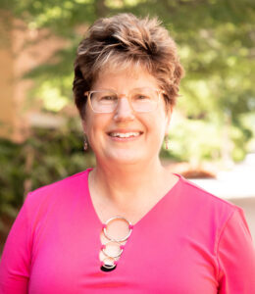
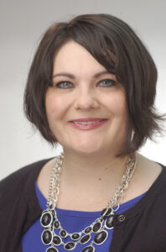
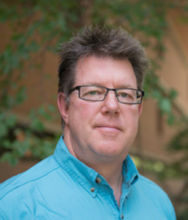
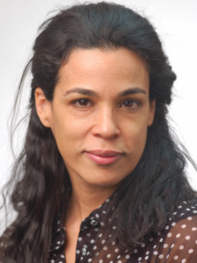
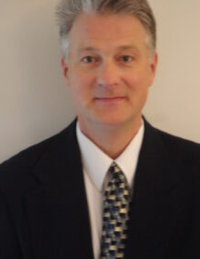
UMBC Committee on Strategies and Tactics for Recruiting to Increase Diversity and Excellence (STRIDE)
Lauren Edwards
Associate Professor
Public Policy
Tim Topoleski
Professor
Mechanical Engineering
Lisa Kelly
Professor
Chemistry
and Biochemistry
John Schumacher
Professor
Sociology, Anthropology, and Public Health
Rachel Brewster
Professor
Biological Sciences

Slide 4
Poll:
Have you experienced a failed search?

Slide 5
Guiding Principle
The on-campus visit is a two-way interviewing process. Candidates are also interviewing us.
Show them that you will make great colleagues!

Slide 6
Conversation Goals
Make virtual interviews purposeful and welcoming
Plan for great on-campus visits
Gathering useful feedback post-visit that aids in better decision-making

Slide 7
The First Interview
Phone or Virtual

Slide 8
Break Out
What is the purpose of this stage of the process?
What are the goals of these interviews?

Slide 9
Virtual Interview Planning/Preparation
Articulate goals with committee
Develop core set of questions for candidates
Decide who will ask what questions
Set time for each question
Information for Candidate - logistics
Technical Issues
Short pre-meeting
Time zone differences
Inclusion in pre-meeting
Point out closed captioning (CC)
Ask if there is anything we can provide/facilitate
Develop plan for evaluation

Slide 10
Poll:
Does your department
provide questions to the
candidate before
the interview?

Slide 11
Up for Discussion
How can core questions on scholarship/teaching/DEAI be phrased to reveal information that is not readily retrievable from the candidate’s application ?

Slide 12
Examples of Core Questions
Which publication(s) are you most proud of? Or, which publications do you feel best represent your interests and direction(s) for the future? Or, Which best represent you as a scholar?
What is your teaching philosophy of working with struggling students?
What are particular challenges with promoting diversity in your discipline?
What drew you to this position? And UMBC?
How do you see yourself contributing to this position, to the department and to the institute as a whole?

Slide 13
A Welcoming Virtual Introduction
Make all candidates feel welcome and comfortable
Personal introductions and pronouns
Remind participants to turn on camera and update name/pronouns
Leave time for interviewee to ask questions

Slide 14
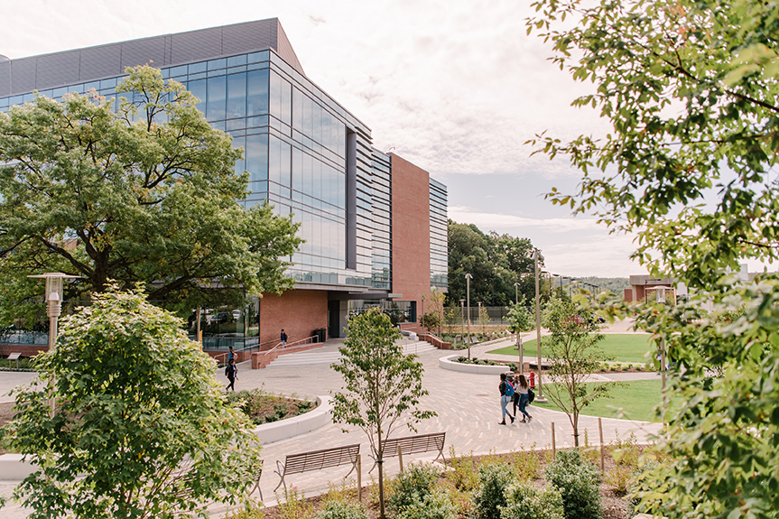
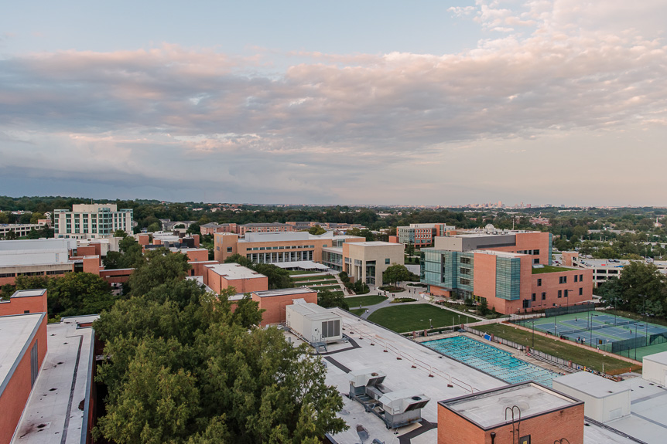
On-Campus
Visits

Slide 15
Break Out
From either position:
What is the worst interviewing practice/instance have you seen?
What is the best?

Slide 16
Planning with the Candidate
Initial questions for the candidate:
Airline/train and hotel preferences
Dietary preferences/restrictions
Transportation preferences/needs
Getting around campus
Presentation needs/preferences
Meetings with campus affinity groups

Slide 17
Planning in the Department: Logistics
Pay expenses up front
Consider contingencies for internal candidates
Location accessibility of meetings/events
Aesthetic of spaces

Slide 18
Planning in the Department:
People Management
For anyone that is interviewing or meeting the candidate:
Candidate and position information as appropriate
Questions not to ask
Ideas of questions to ask or topics to discuss, if needed
Clear expectations and manner of getting feedback on candidate

Slide 19
Planning in the Department: Agenda
More information, not less
Provide brief information on people, their role, and purpose of that part of the interview
Name of escorts, pick up, and meal guests
Built in down time and walking time

Slide 20
Planning in the Department:
Hospitality Considerations
Offer water/coffee/tea throughout the visit
If space, have a candidate only space
Break before talk
Comfort at meals and rethinking one-on-ones

Slide 21
During the Interview
Intro and outro meetings with candidate
Give candidates your attention and remind others
Be prepared for allyship, if needed

Slide 22
Idea: Information Packet
Circumvent questions that candidate may not want to ask
In the packet:
University information and highlights
Department information and highlights
Info on employee benefits and policies
Letter from STRIDE
DEIA efforts on campus, including faculty development
Affinity groups
Child-care and work-life balance efforts
Community highlights

Slide 23
What To Ask and Not Ask
During Interviews
General Guidelines:
Ask questions that are relevant to performing the job
Strive for consistency (asking similar questions to all applicants)
If you are uncertain whether a question is OK, don’t ask it
Maintain personal space

Slide 24
What Not to Ask
TOPIC | INAPPROPRIATE QUESTIONS | EXAMPLE
Marital Status | Re: spouse or lack thereof | What does your wife do? (Umm - Actually, I have a husband.)
Family Status | Children, childcare, etc. | Do you have kids?
Age | Any inquiry about age. | What year did you graduate from high school?
National Origin, Race, Religion | Any inquiry about race, nationality, religion. | Where were your parents from?
Gender or Sexual Orientation | Any inquiry about gender or sexual orientation.
Disability Status | Any inquiries about physical and mental health | Will your disability affect your teaching?
https://umbc.app.box.com/v/interviewqguidelinesPDF

Slide 25
After the Interview
Meet with search committee as soon as possible after the completion of each visit
Review candidate based on agreed upon rubric
After all interviews, meet to discuss and compare candidates
Ensure you are following the agreed upon rubric for the position
Follow your agreed-upon process for making hiring decision and your evaluation criteria
Use only job specific attributes to evaluate strengths and weakness
Be able to defend every decision with criteria
Communicate with successful and unsuccessful candidates in a timely manner
Decide how to proceed if top candidate declines the offer

Slide 26
Guiding Principle
The on-campus visit is a two-way interviewing process. Candidates are also interviewing us.
Show them that you will make great colleagues!

Slide 27
Just-in-Time Consultations (Q&A)
For those interested:
Please stay for informal Q&A and discussion about your interview process.

