Slide 1
Best Practices for Evaluating Applications
UMBC STRIDE
Wednesday, November 8, 2023
12:00-1:00pm
1:00-1:30pm (optional specific Q&A)
Next Up: Best Practices for Interviewing
Wednesday, November 29, 2023
12:00-1:00pm
1:00-1:30pm (optional specific Q&A)
WebEx

Slide 2
STRIDE
UMBC Committee on Strategies and Tactics for Recruiting to Increase Diversity and Excellence
STRIDE fellows provide faculty peer education supporting search committees and departments/programs to recruit, retain, and promote diverse faculty and foster more inclusive and equitable academic spaces for faculty.
As a peer education resource, the UMBC STRIDE Committee does not create or enforce institutional policy or approve faculty searches

Slide 3
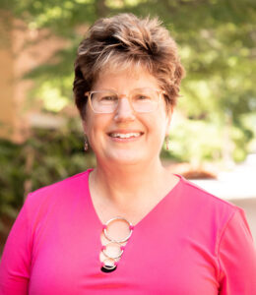
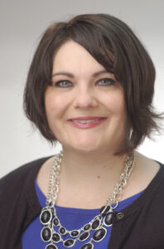
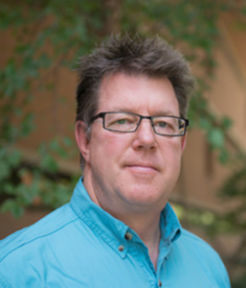
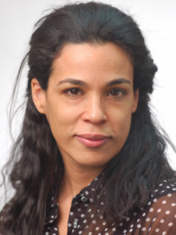
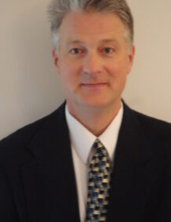
UMBC Committee on Strategies and Tactics for Recruiting to Increase Diversity and Excellence (STRIDE)
Lauren Edwards
Associate Professor
Public Policy
Tim Topoleski
Professor
Mechanical Engineering
Lisa Kelly
Professor
Chemistry
and Biochemistry
John Schumacher
Professor
Sociology, Anthropology, and Public Health
Rachel Brewster
Professor
Biological Sciences

Slide 4
Conversation Goals
Recognizing Bias
Rubrics
Developing
Calibrating & Using
Evaluation Process Issues
DEI Statements

Slide 5
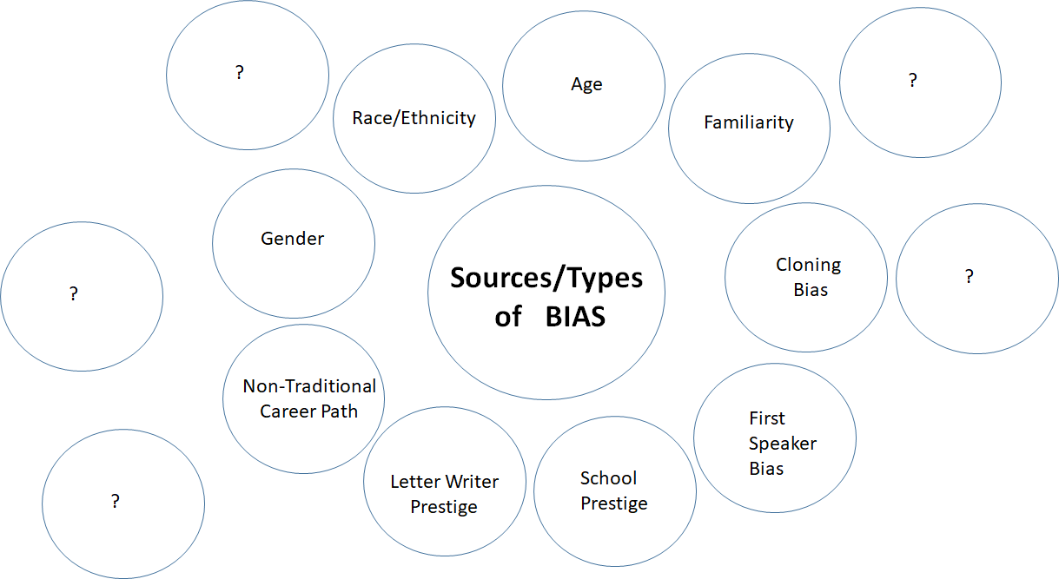

Slide 6
Video:
A Fictional UMBC Search Committee Meeting…
Breakout Rooms:
Identify problematic elements?
Rewrite the script, what to do differently?

Slide 7
Back to Reality - You Have a Faculty Search!
SYSTEMATIC PROCESS REDUCES BIAS

Slide 8
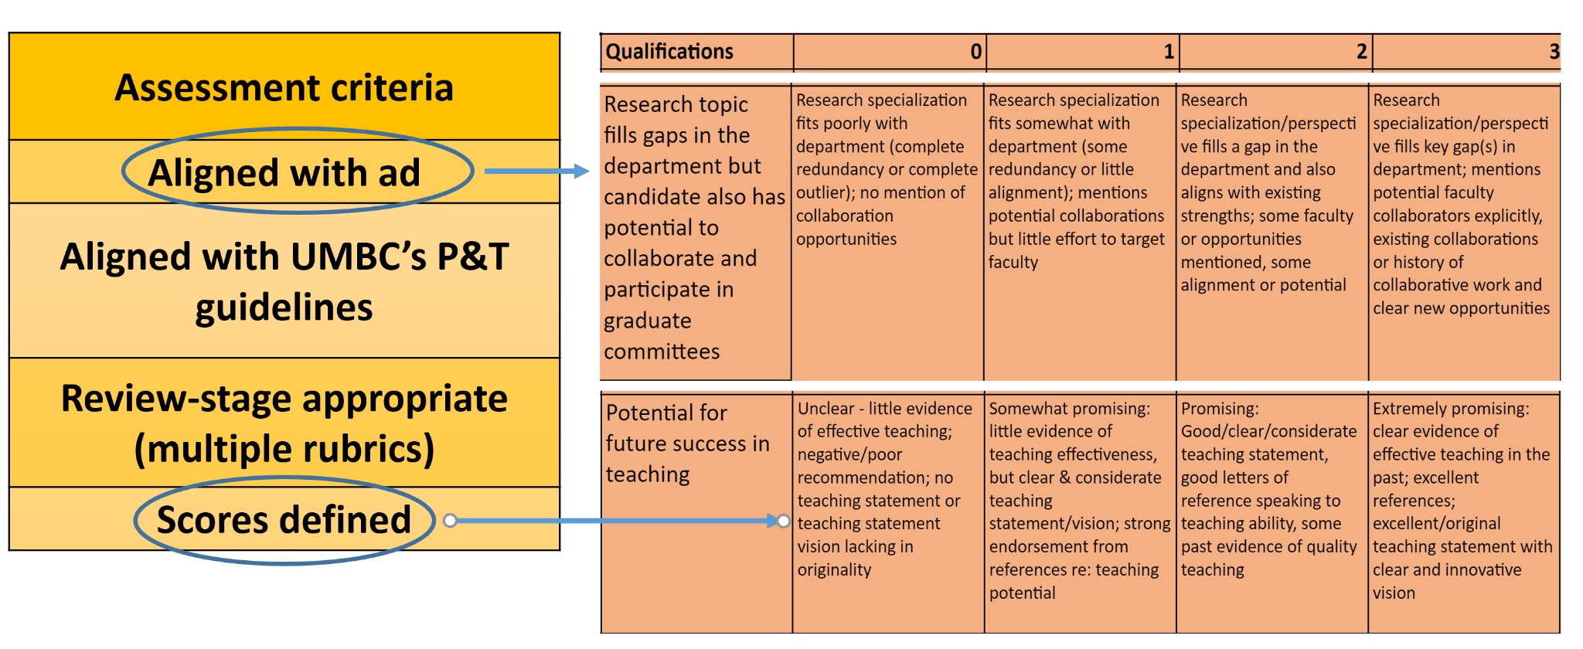
Developing the Rubric(s)

Slide 9
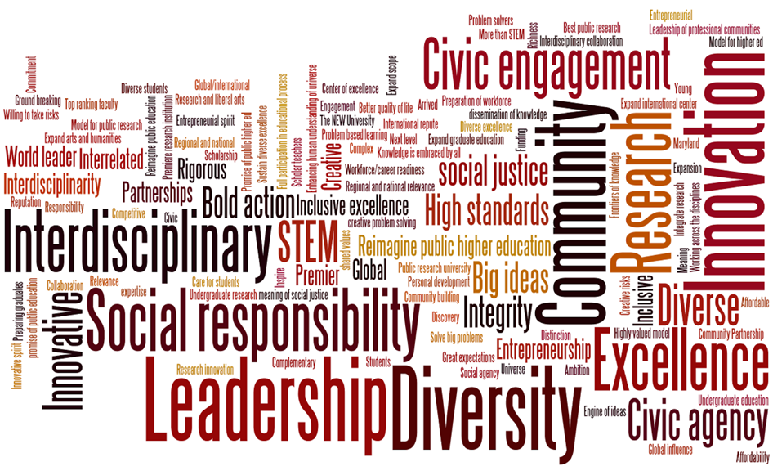
Evaluating DEIA Statements
EXAMPLES (PAST AND FUTURE)
Knowledge and commitment to equity, diversity, inclusion, and access
Knowledge of underrepresentation in their field(s);
Involvement with recruitment, retention, and/or mentoring of underrepresented students;
Organization of, or engagement in, seminars, etc., that address concerns of underrepresented groups;
Presentations or performances for underrepresented communities;
Participation in programs aimed at increasing the pipeline of underrepresented groups entering higher education;
Public service activities and invitations to give talks within the field that address the needs of culturally diverse groups;

Slide 10
Evaluating DEIA Statements
Sample Rubric

Slide 11
Evaluating DEIA Statements
Candidate Statement:
Throughout my education, I have been particularly mindful of barriers faced by women and underrepresented people of color in the sciences. While a graduate student, I participated in my university’s K-12 outreach program to engage female high school students in science for three years. As a professor, I am interested in working with the campus to expand this kind of “lab-based” outreach to K-12 educators from low performing, majority-minority middle schools, so they can help ignite the interest of their students in science. With help from the campus, I will recruit an educator each year to work for the summer on research in my lab, expose them to new ideas and developments in my research area, and encourage them to bring some of these into their curriculum. I would also work to engage other faculty in science as part of their NSF Broad participation in their research grant proposals.
(Adapted From UCLA “Short Diversity Statement Examples” )

Slide 12
Lessons Learned
Implementation of multiple rubrics as the evaluation/interview process evolves
Calibrating our rubrics is important*
*Culpepper, D. et al. (2023). Do rubrics live up to their promise? Examining how rubrics mitigate bias in faculty hiring. J. Higher Ed., 94(7), 823.

Slide 13
Developing Multiple Rubrics
* Example of multiple rubrics (from UMBC Political Science):
Rubric 1: Preliminary Screening of Candidates
Rubric 2: Committee Review of Candidate Applications
Rubric 3: Committee Review of Candidate Interviews on Webex
Rubric 4: Departmental Review of Top Candidates
Rubric 5: Departmental Review of Interviewees
Poll question: Have you used multiple rubrics in faculty searches?

Slide 14
Evolution of a Rubric
Adapted from Thomas, K. and Nguyen, K. “A Model for Diversifying Faculty Recruitment,” Nature (Career Column), 05 Oct. 2021.

Slide 15
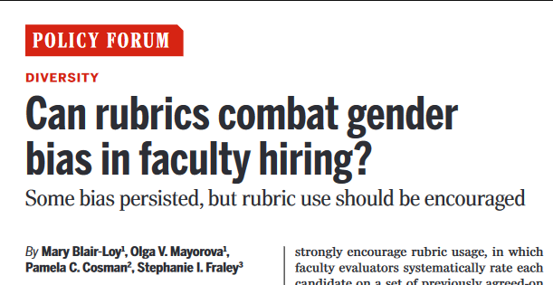
Blair –Loy, et al. (2022). Can rubrics combat gender bias in faculty hiring? Science. 377(6001) 35-37.

Slide 16
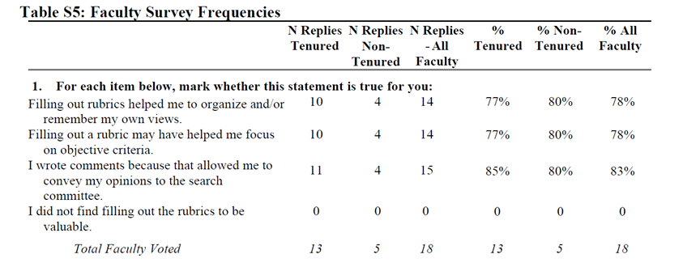
Faculty Survey on Rubrics
Blair –Loy, et al. (2022). Can rubrics combat gender bias in faculty hiring? Science. 377(6001) 35-37.

Slide 17
Calibrating “Shared understanding” of rubric & scoring
Calibrate Rubric With Search Committee on ~3 applicants
1. As a committee, discuss each rubic element, reviewing criteria and rating categories. Discuss examples of the kinds of evidence motivates low, medium, or high scores.
2. Select 3 applicants for applying the rubric.
3. Apply the rubric with each committee member individually scoring applications & adding comments.
4. Analyze the scores assigned to each application across all categories and by all committee members.
5. DISCUSS interpretations and discrepancies between reviewer scores & comments.
6. Recalibrate the scoring/assessment system as needed.
7. Apply the agreed upon rubric to the entire applicant pool.

Slide 18
Using Rubrics
It’s a tool to help with consistency and fairness in the process
A rubric is not a substitute for active committee deliberations
Can help open discussion of how members define concepts like “merit,” “quality,” “excellence,” and “potential.”
Do committee members assume these concepts have singular definitions?
Comments section can help document key evidence

Slide 19
Using Rubrics -Examples
Rubric 1
Teaching | Rating | Comments
Rank the candidate’s ability to teach undergrad/grad courses (in area) and its fundamentals. List courses applicant would be qualified to teach. | Excellent Good Neutral Fair Poor

Slide 20
Using Rubrics
Rubric 2
Criterion (commensurate with experience) | Scoring 0-5 Scale, where: 5=excellent; 4=very good; 3=satisfactory; 2=unsatisfactory; 1=poor; 0=no evidence/cannot determine
Teaching
Potential for/evidence of teaching courses in (dept desired area) and related courses using evidence-based teaching tools and pedagogical strategies

Slide 21
Using Rubrics
Rubric 3
Teaching | Rating 1-5 | Comments
Potential for high quality teaching, evidence demonstrating teaching competence, evidence of innovative approaches to teaching, demonstrations, and special class exercises, videotapes, electronic materials, and the like.

Slide 22
Using Rubrics
Rubric 4
Teaching excellence | 1= No evidence, 2= Little evidence 3= Satisfactory/indirect evidence 4= Above average evidence 5= Outstanding evidence | Comments/Evidence:
Has experience teaching and mentoring undergrad/grad students; demonstrates potential contributions to the core curricula. Teaching excellence may be evidenced by: the number and type of courses prepared, number of semesters taught, student outcomes, student assessments, teaching improvement/course development activities, experience developing curricula, student advising activities, and/or directing/supporting student capstone projects.

Slide 23
Process: Search Committee Meeting Dynamics
Be mindful of meeting dynamics and “first speaker bias” and other issues.
Use of rubrics makes the process more systematic
Challenges:
Rushed meetings can introduce bias as “short cuts”
Do members have reasonable time to review applications?
Multiple meetings frequently needed.

Slide 24
Resource List
Sample rubrics and resources
University of Michigan STRIDE recommended readings
Kaiser, J. (2023). To reduce ‘reputational bias,’NIH may revamp grant scoring. Science (New York, NY), 379(6629), 223.
“Evaluating Job Candidates: Choosing the Short List and Treating Interviewees Equitably” in A. J. Stewart and V. Valian An Inclusive Academy: Achieving Diversity and Excellence, MIT Press (2022), pgs. 201 - 242.
Next Up: Best Practices for Interviewing
Wednesday, November 29, 2023
12:00-1:00pm
1:00-1:30pm (optional specific Q&A)
WebEx

Slide 25
Just-in-Time Consultations (Q&A)
For those interested:
Please stay for informal Q&A and discussion about your evaluation process.

